Slide 1
Detecting web application attacks through language recognition
Eduardo Giménez, PhD
Tilsor S.A. / ICT4V – WAFINTL Project
April 2017
Notes:
Soy E.G de WAFINTL.
Experimento entre setiembre del año pasado y febrero de este año, pero que las ideas remontan al workshop con Kittler.
Que tuvo primeramente otra orientación (en la línea de lo que ha estado haciendo Rodrigo Martínez), pero que no me pareció relevante contar.
Algo medio redondo como para ser contado. Y además Nicolás se interesa a temas similares, me pareció que podía aportar estar

Slide 2
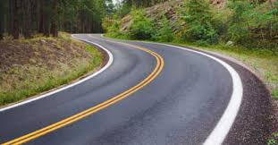
Context & motivations

Slide 3
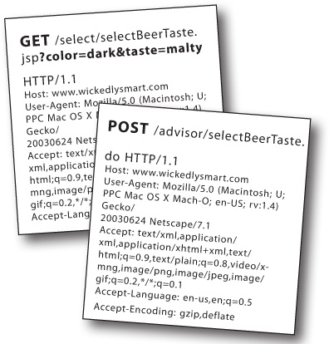




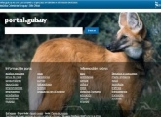




Context – Web applications
HTTP Request
Application Server
Web Browser
Legit user
Internet
Web Application
Firewall (WAF)
Database Server
Attacker

Slide 4
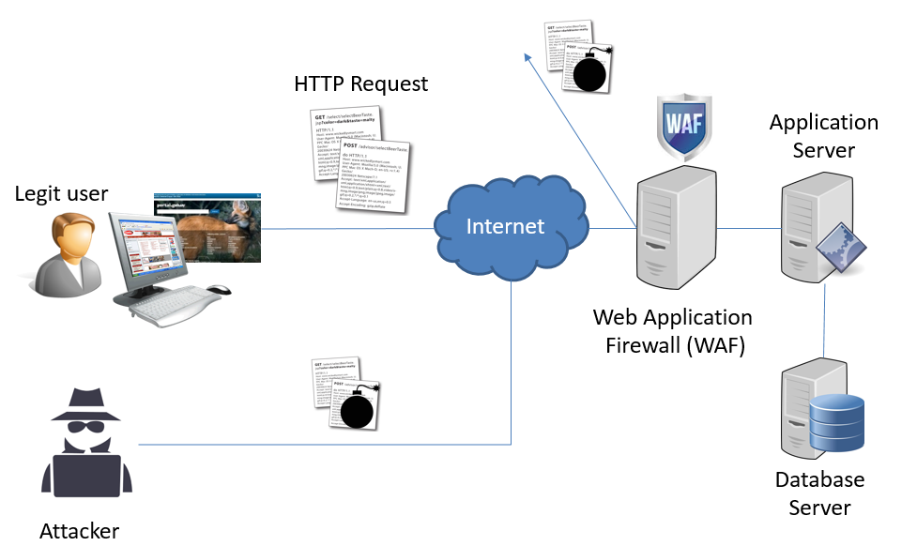


Our problem (in WAFINTL)
Protecting Uruguayan e-Government web applications
Registering and displaying information through web forms and rather static HTML pages.
Virtual patching (WAF)
Non-invasive approach
Quick deployment
Machine Learning:
Provide a more plastic and flexible approach than filtering rules

Slide 5
Code injection attacks
Malicious provision of unexpected input data which modifies the intended purpose of an executable, interpreted piece of code.
Comes from incorrect input sanitization (escaping), untyped expressions, bad statement assembling
statement = "SELECT * FROM users WHERE name = '" + userName + “ ';"
userName := Eduardo Giménez
statement = "SELECT * FROM users WHERE name = ‘Eduardo Giménez’;"

Slide 6
Code injection attacks
Malicious provision of unexpected input data which modifies the intended purpose of an executable, interpreted piece of code.
Comes from incorrect input sanitization (escaping), untyped expressions, bad statement assembling
statement = "SELECT * FROM users WHERE name = '" + userName + “ ';"
userName := Eduardo Giménez ‘ OR ‘1’=‘1
statement = "SELECT * FROM users
WHERE name = ‘Eduardo Giménez’ OR ‘1’=‘1’;"

Slide 7
Code injection attacks
Malicious provision of unexpected input data which modifies the intended purpose of an executable, interpreted piece of code.
Comes from incorrect input sanitization (escaping), untyped expressions, bad statement assembling
statement = "SELECT * FROM users WHERE name = '" + userName + “ ';"
userName := Eduardo Giménez’; DROP TABLE users; SELECT userinfo WHERE ‘t’=‘t
statement = "SELECT * FROM users
WHERE name = ‘Eduardo Giménez’;
DROP TABLE users;
SELECT userinfo WHERE ‘t’=‘t’

Slide 8

Code injection attacks
Malicious provision of unexpected input data which modifies the intended purpose of an executable, interpreted piece of code.
Comes from incorrect input sanitization (escaping), untyped expressions, bad statement assembling
Same occurs for several other programming languages used in web applications: XLDAP, OS commands, XPath, XML parsers, SMTP headers, NoSQL, etc.

Slide 9

Two complementary approaches
Focus on attacks: identify attack signatures
ML: very flexible for recognizing variants of those attacks
Very few false positives (much better than using rules)
But what about “new” attack vectors?
Training (=labelling) may be difficult and expensive
Focus on the intended application behavior:
Positive definition of what a “correct” input is
Pattern recognition approach: identify outliers
Try to avoid or simplify labelling step

Slide 10
A language perspective
Remark: this is a problem about mixing languages.
userName := Eduardo Giménez ’ ; DROP Table users; SELECT userinfo WHERE ‘t’=‘t
These are
Uruguayan names
(intended
language)
This is SQL: a complete different language.
Outlier (unexpected) value!

Slide 11
A well studied NLP problem
Recognizing language blocks in a piece of text.
Widely used in many Internet applications
Jorge Luis Borges (1899–1986), a giant in Latin American letters, wrote numerous books of poetry, fiction, and essays, and was a prodigious translator of authors such as Kipling, Woolf, Faulkner, and Poe. He is the author of this wonderful opening:
A mi, tan luego, hablarme del finado Francisco Real. Yo lo conocí, y eso que éstos no eran sus barrios porque él sabía tallar más bien por el Norte, por esos laos de la laguna de Guadalupe y la Batería. Arriba de tres veces no lo traté, y ésas en una misma noche, pero es noche que no se me olvidará, como que en ella vino la Lujanera porque sí a dormir en mi rancho y Rosendo Juárez dejó, para no volver, el Arroyo.
English
Spanish
Notes:
Internet: quizás tengo que proponer traducir esto, quizás me sirve para una búsqueda con tal lenguaje, etc.
También usado para predecir lo que va a tipear en teléfonos celulares, etc.

Slide 12
N-grams
Measure the frequencies of consecutive letters.
Each language has a characteristic signature in terms of n-gram frequencies.
Jorge Luis Borges (1899–1986), a giant in Latin American letters, wrote numerous books of poetry, fiction, and essays, and was a prodigious translator of authors such as Kipling, Woolf, Faulkner, and Poe. He is the author of this wonderful opening: A mi, tan luego, hablarme del finado Francisco Real. Yo lo conocí, y eso que éstos no eran sus barrios porque él sabía tallar más bien por el Norte, por esos laos de la laguna de Guadalupe y la Batería. Arriba de tres veces no lo traté, y ésas en una misma noche, pero es noche que no se me olvidará, como que en ella vino la Lujanera porque sí a dormir en mi rancho y Rosendo Juárez dejó, para no volver, el Arroyo.

Slide 13
N-grams in our problem
Measure the frequencies of consecutive letters.
Each language has a characteristic signature in terms of n-gram frequencies.
Eduardo Giménez ’ ; DROP Table users; SELECT userinfo WHERE ‘t’=‘t
Very low frequency in Uruguayan names

Slide 14
Research program
Develop a ML, non supervised approach for detecting code injection in web applications based on a language perspective and the use of n-grams as attributes.
Learn / check feasibility applying the n-gram approach to a case study
Compare several outlier detection criteria
Extend to attack classification

Slide 15
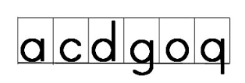
Why the n-gram approach?
Because it is simple
Because it is successfully used in other domains
Because it circumvents the problem of breaking useful sequences during tokenization
‘;DROP+TABLE+users;SELECT+userinfo+WHERE+‘t’=‘t
DROP / TABLE / users / SELECT / userinfo / WHERE / ‘t’=t’
‘; / ;D / DR / RO / OP / P+ / +T / TA / AB / BL / LE / E+ / +u / us / se / er / rs / s; /…

Slide 16

Vision
The model must be simple.
The method shall explain why a request is an outlier
It must work on the raw, low-level data

Slide 17
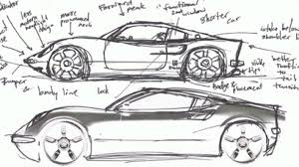
Data model

Slide 18
HTTP requests
53 fields
POST http://localhost:8080/tienda1/publico/anadir.jsp HTTP/1.1
User-Agent: Mozilla/5.0 (compatible; Konqueror/3.5; Linux) KHTML/3.5.8 (like Gecko)
Pragma: no-cache
Cache-control: no-cache
Accept: text/xml,application/xml,application/xhtml+xml,text/html;q=0.9,text/plain;q=0.8,image/png,*/*;q=0.5
Accept-Encoding: x-gzip, x-deflate, gzip, deflate
Accept-Charset: utf-8, utf-8;q=0.5, *;q=0.5
Accept-Language: en
Host: localhost:8080
Cookie: JSESSIONID=933185092E0B668B90676E0A2B0767AF
Content-Type: application/x-www-form-urlencoded
Connection: close
Content-Length: 68
id=3&nombre=Vino+Rioja&precio=100&cantidad=55&B1=Añadir+al+carrito
Subfields may depend on the URL
From now on, “field” stands for either an HTTP field or an application subfield.
Some of them may have an internal structure made of field definitions (field=value) separated by a symbol (&).

Slide 19

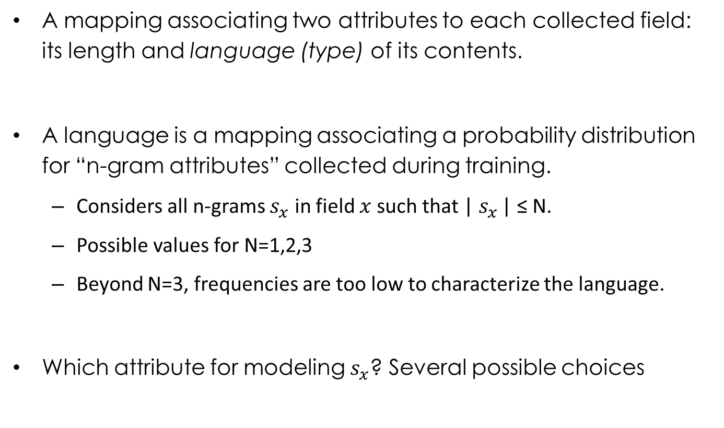
The model
A mapping associating two attributes to each collected field: its length and language (type) of its contents.
A language is a mapping associating a probability distribution for “n-gram attributes” collected during training.
Considers all n-grams $s_{x}$ in field $x$ such that | $s_{x}$ | ≤ N.
Possible values for N=1,2,3
Beyond N=3, frequencies are too low to characterize the language.
Which attribute for modeling $s_{x}$? Several possible choices

Slide 20
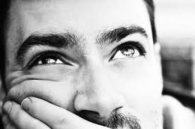

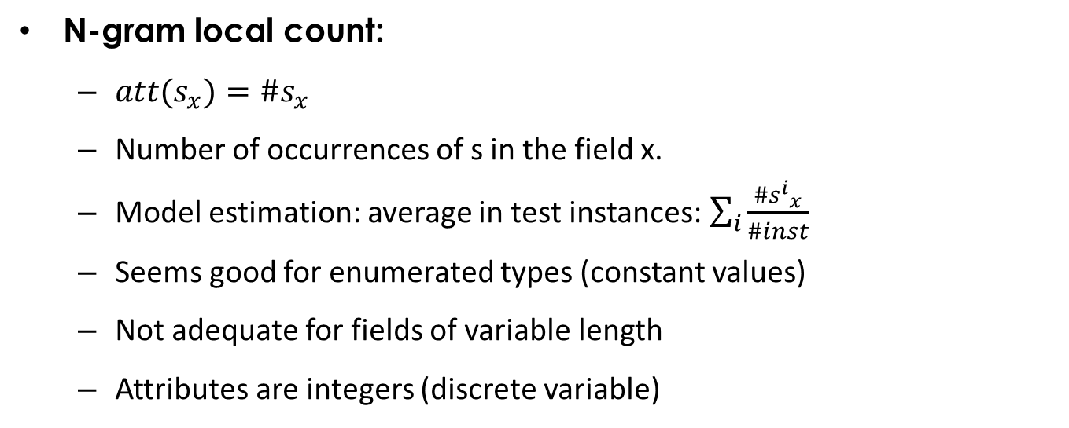
Which attribute for $s_{x}$?
N-gram local count:
$att{(s}_{x})=\#s_{x}$
Number of occurrences of s in the field x.
Model estimation: average in test instances: $\sum_{i}{\frac{\#{s^{i}}_{x}}{\#inst}}$
Seems good for enumerated types (constant values)
Not adequate for fields of variable length
Attributes are integers (discrete variable)
Accept-Encoding: x-gzip, x-deflate, gzip, deflate
att(“x-”) = 2

Slide 21
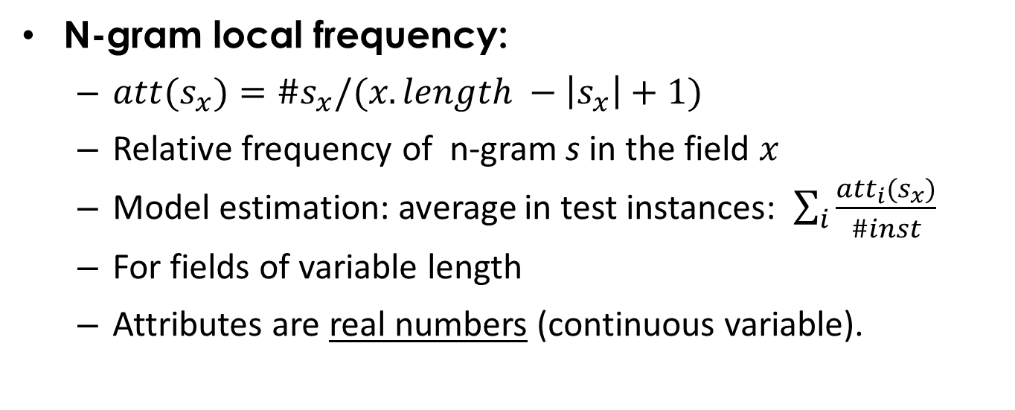

Which attribute for $s_{x}$?
N-gram local frequency:
$att{(s}_{x})=\#s_{x}/(x.length −\left|s_{x}\right|+1)$
Relative frequency of n-gram s in the field $x$
Model estimation: average in test instances: $\sum_{i}{\frac{{att}_{i}(s_{x})}{\#inst} }$
For fields of variable length
Attributes are real numbers (continuous variable).
nombre= Vino+Rioja
att(“o”) = 2/10 = 0,2

Slide 22

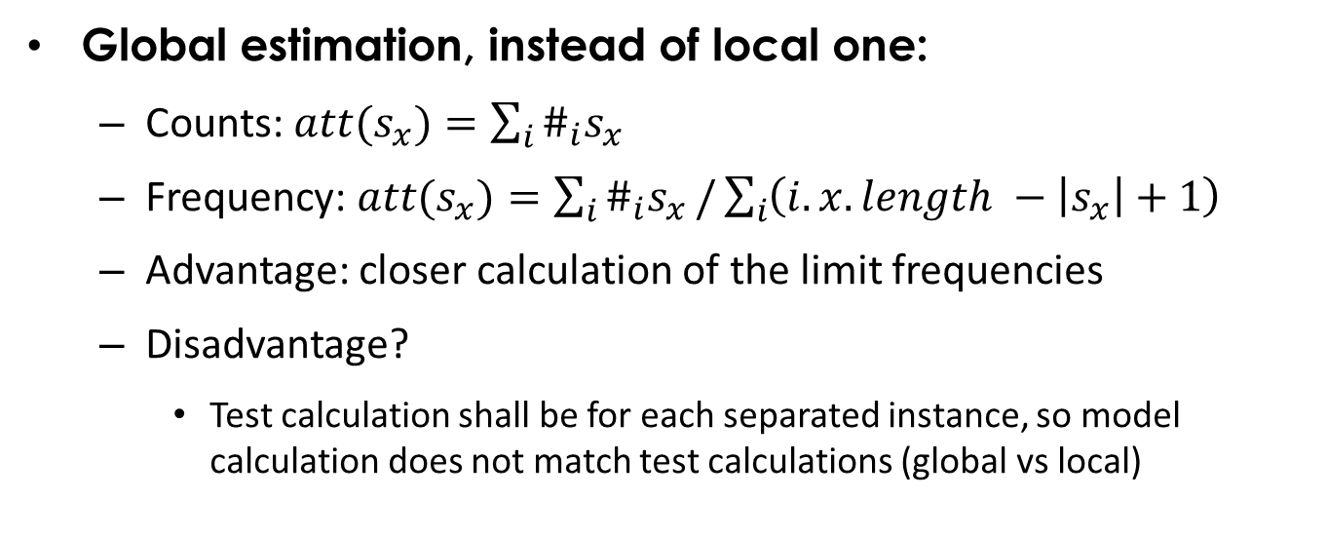
Which attribute for $s_{x}$?
Global estimation, instead of local one:
Counts: $att{(s}_{x})=\sum_{i}{\#_{i}s_{x}}$
Frequency: $att{(s}_{x})=\sum_{i}{\#_{i}s_{x}}/\sum_{i}{\left(i.x.length −\left|s_{x}\right|+1\right)}$
Advantage: closer calculation of the limit frequencies
Disadvantage?
Test calculation shall be for each separated instance, so model calculation does not match test calculations (global vs local)
0,2
nombre= Vino+Rioja
att(“o”) = 4/23 = 0,17
nombre= Jamón+serrano
0,15

Slide 23
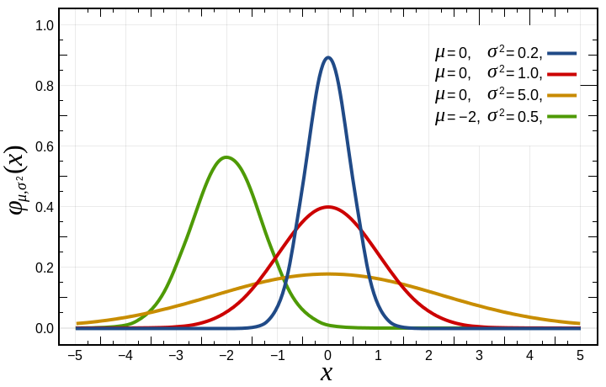
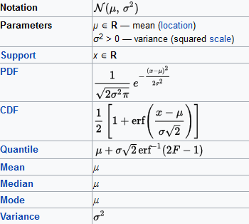
Attribute distribution
We assume that the n-gram attributes follow a normal distribution (frequency is a real number)

Slide 24
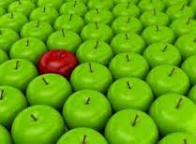
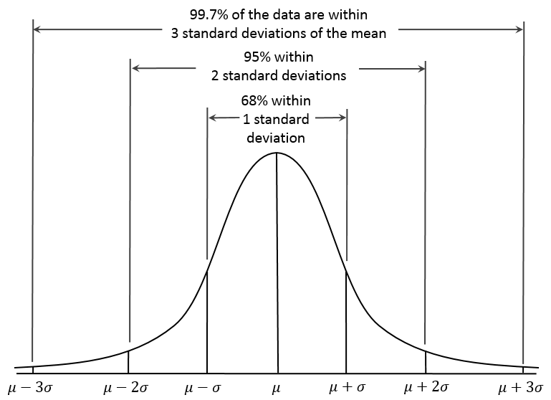
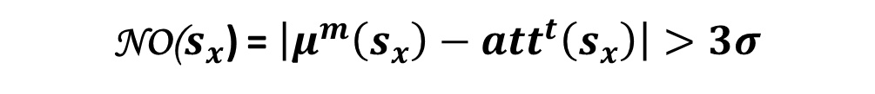
N-gram outlier criteria v1
99.7% should be at most at 3σ from the mean
NO($s_{x}$) = $\left|μ^{m}\left(s_{x}\right)−{att}^{t}\left(s_{x}\right)\right|>3σ$

Slide 25
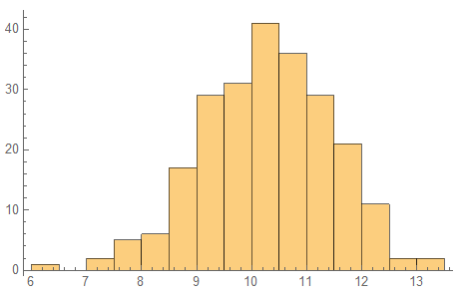
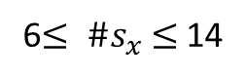
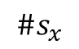
N-gram outlier criteria v2
Min – Max of the training dataset
Decreases false positives by 50%
NO($s_{x}$) = ${not(Min}^{m}\left(s_{x}\right)≤{att}^{t}\left(s_{x}\right) ≤{Max}^{m}\left(s_{x}\right)$)
#instances
$$\#s_{x}$$
Min = 6
6$≤ \#s_{x}$ $≤$14
Max = 14

Slide 26

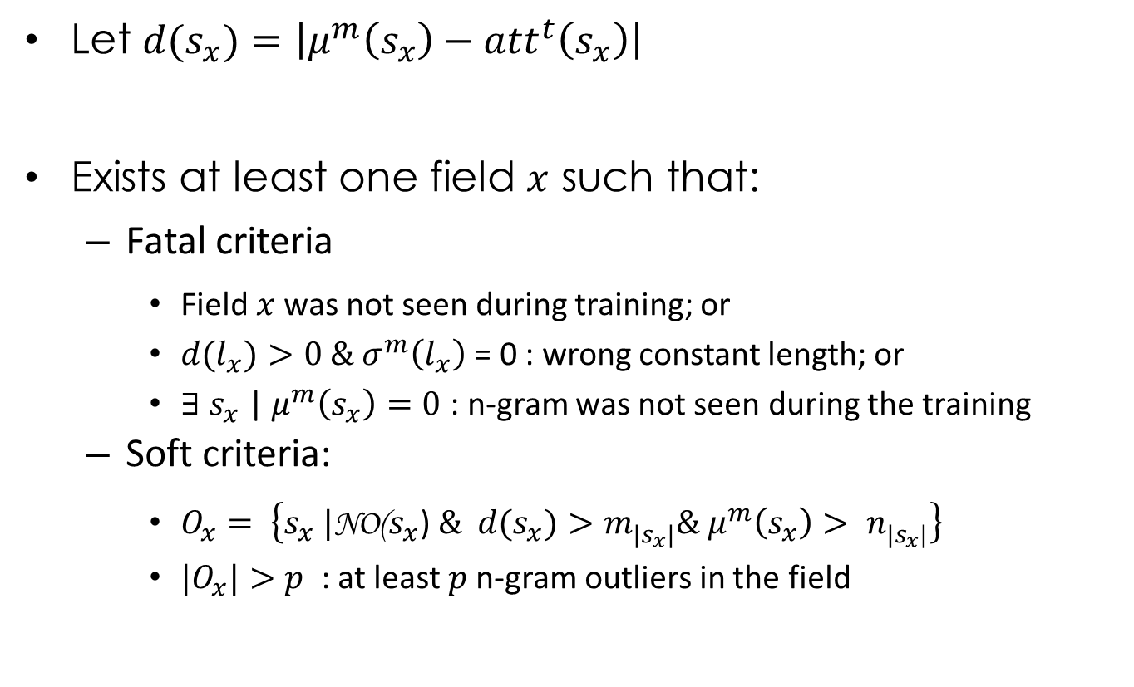
Instance outlier
Let ${d(s}_{x})=\left|μ^{m}\left(s_{x}\right)−{att}^{t}\left(s_{x}\right)\right|$
Exists at least one field $x$ such that:
Fatal criteria
Field $x$was not seen during training; or
$d{(l}_{x})>0 \& σ^{m}\left(l_{x}\right)$ = 0 : wrong constant length; or
${∃ s}_{x}$ |$μ^{m}\left(s_{x}\right)=0$ : n-gram was not seen during the training
Soft criteria:
$O_{x}= \left\{s_{x} |\text{NO}\text{(}s_{x}\text{)} \&{ d(s}_{x})>m_{|s_{x}|}^{}\& μ^{m}\left(s_{x}\right)> n_{|s_{x}|}^{}\right\}$
${|O}_{x}|>p$ : at least $p$n-gram outliers in the field

Slide 27
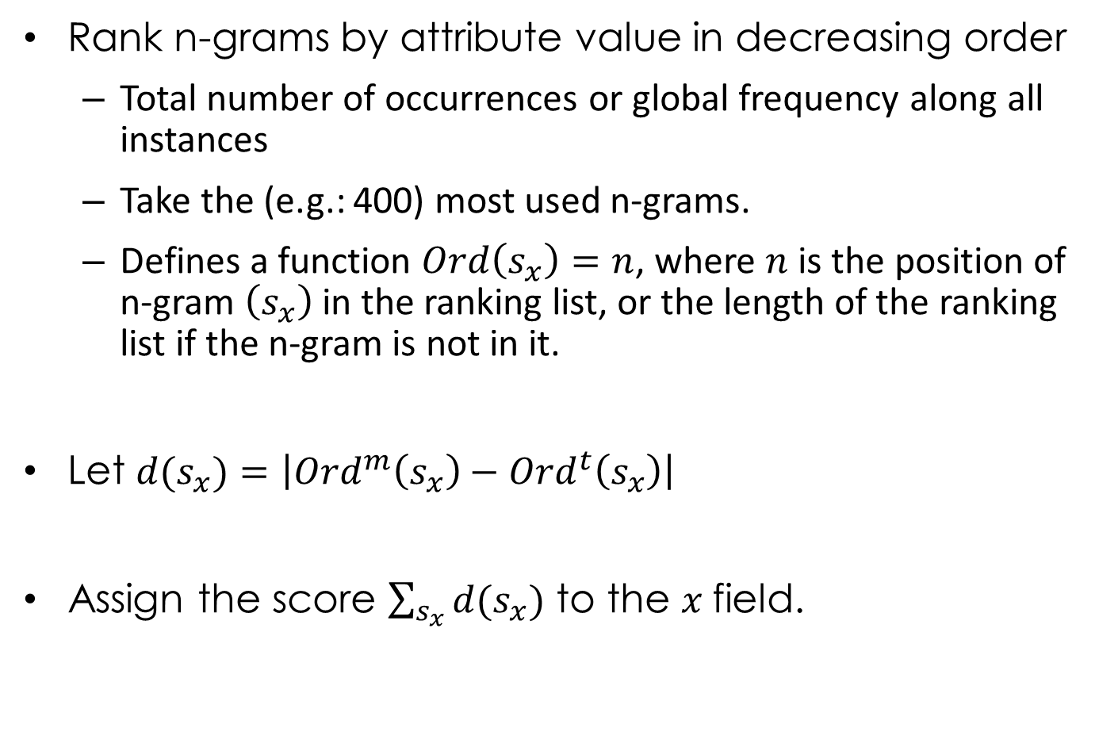
N-gram outlier criteria v3
Rank n-grams by attribute value in decreasing order
Total number of occurrences or global frequency along all instances
Take the (e.g.: 400) most used n-grams.
Defines a function $Ord\left(s_{x}\right)=n$, where $n$ is the position of n-gram $\left(s_{x}\right)$ in the ranking list, or the length of the ranking list if the n-gram is not in it.
Let ${d(s}_{x})=\left|{Ord}^{m}\left(s_{x}\right)−{Ord}^{t}\left(s_{x}\right)\right|$
Assign the score $\sum_{s_{x}}{{d(s}_{x})}$ to the $x$field.
“N-gram based text categorization”, Cavnar & Trenkle, University of Michigan

Slide 28
Scoring example
Model
DEL
QUE
ION
ELA
CON
Sample
ION
QUE
DEL
ION
WHE
Score
2
0
2
1
5
Is 10 a good or bad score for this field?
Total score = 2+0+2+1+5 = 10

Slide 29
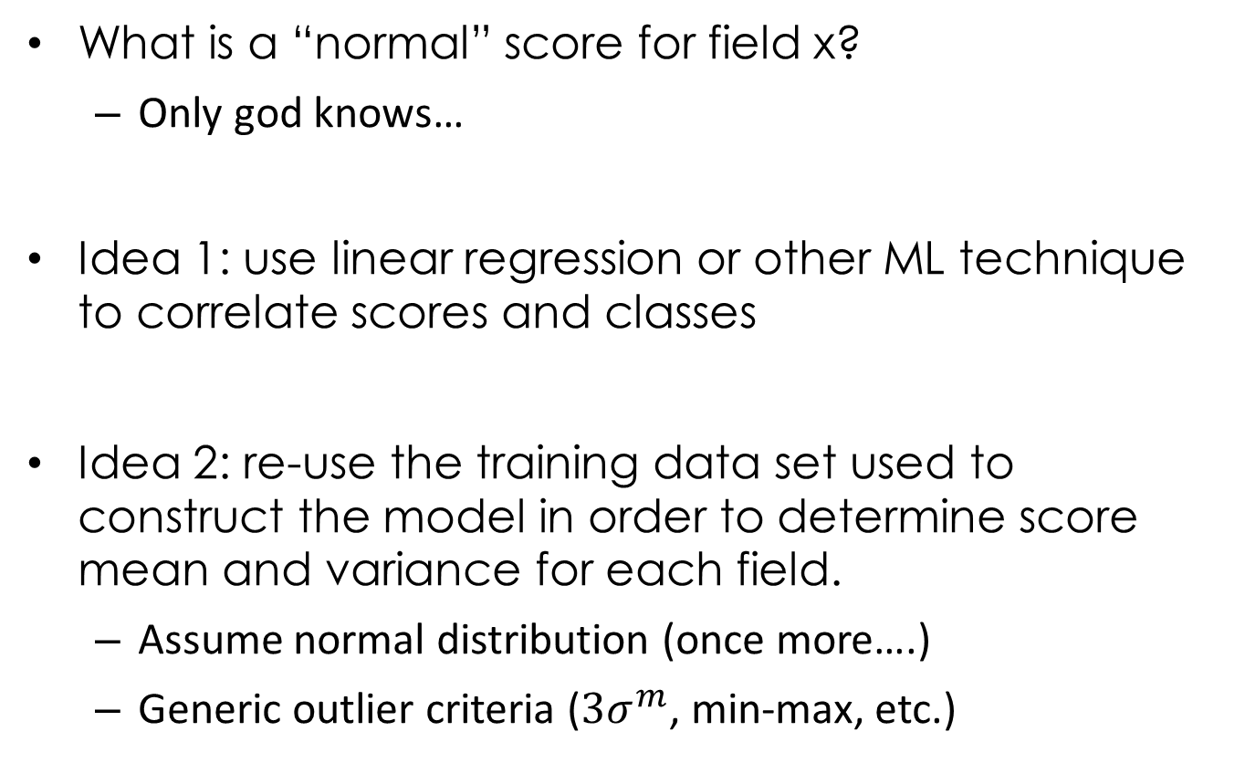
Instance outlier criteria
What is a “normal” score for field x?
Only god knows…
Idea 1: use linear regression or other ML technique to correlate scores and classes
Idea 2: re-use the training data set used to construct the model in order to determine score mean and variance for each field.
Assume normal distribution (once more….)
Generic outlier criteria ($3σ^{m}$, min-max, etc.)

Slide 30

Model Tuning
Problems & solutions

Slide 31
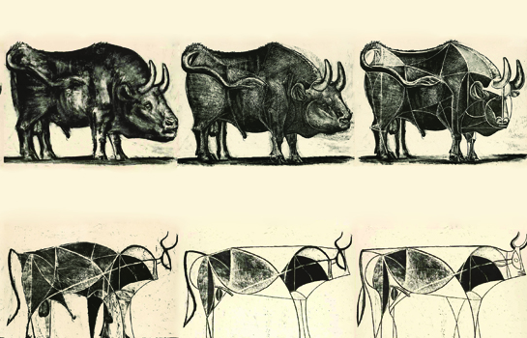
Token abstraction
Not all n-grams are relevant, some distinctions are more problematic than helpful
Example: does the number “13” better characterize valid customer address numbers than number “24”?
Model abstracts away or collapses several symbols
No capital letters (all n-grams translated into small letters)
Accents removed (we don’t have specific priors for them)
Numbers collapsed (all represented as capital letter “N”)

Slide 32
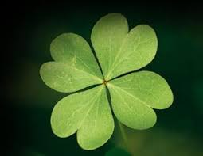
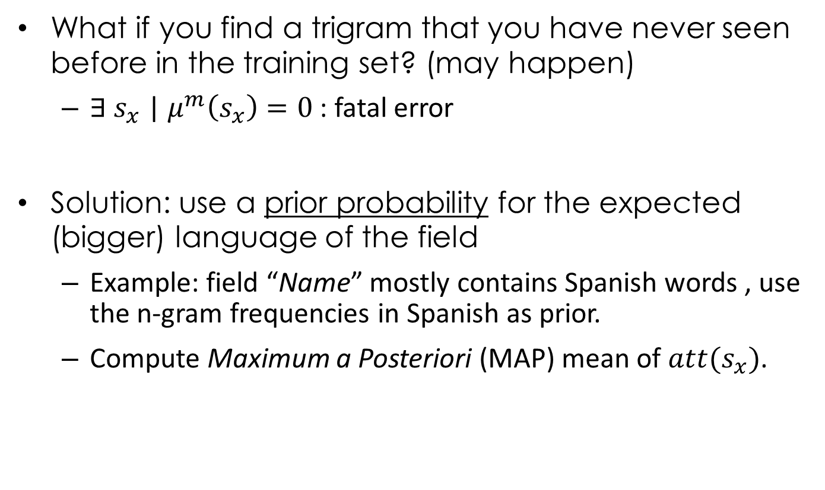
Rare n-grams
What if you find a trigram that you have never seen before in the training set? (may happen)
${∃ s}_{x}$ |$μ^{m}\left(s_{x}\right)=0$ : fatal error
Solution: use a prior probability for the expected (bigger) language of the field
Example: field “Name” mostly contains Spanish words , use the n-gram frequencies in Spanish as prior.
Compute Maximum a Posteriori (MAP) mean of $att{(s}_{x})$.

Slide 33
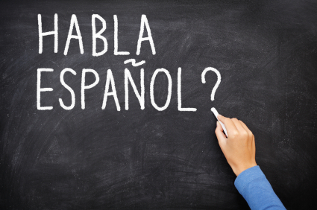
Spanish priors
Several data for monograms, bigrams and trigrams frequencies in different languages.
But hard to find n-gram frequencies including spaces and other punctuation symbols…
Example: which frequency for “n+a” trigram?
Could not find any variance data for Spanish n-grams
Approximated by sigma = 2µ.
“Reason”: frequency 0 (not occurs) should not be an outlier

Slide 34
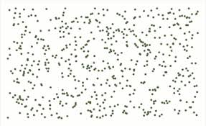
Random data
Some fields are not expected to have a defined “language”.
Example: what is a “normal” password or encrypted cookie?
A password should be any possible sequence made of any possible symbol, all equally distributed (random data). Nothing is an outlier.
Moreover, for security reasons, you should carefully consider pros and cons before learning passwords or storing other sensitive data in your model… but this is another topic.
Such fields are excluded from the model… but should not.
Give raise to some false negatives in the test dataset.
Possible solution?: for such fields, use the negative, classification approach to tackle the problem: look for suspicious sequences rather than for normal values.

Slide 35
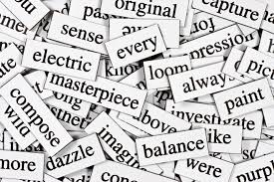
Back to words
Sometimes, words are better than n-grams: when you have a well defined separator.
Example: URL (http://alfresco.ict4v.org/projects/wafintl)
Separator “/” cuts content into better pieces
The occurrence in a sub-directory of a rare trigram which also occurs in the domain can significantly change the frequency of this n-gram in the whole URL.
Solution: for some fields, tokenize splitting into strings separated by a well chosen symbol. Same model.

Slide 36

Implementation

Slide 37
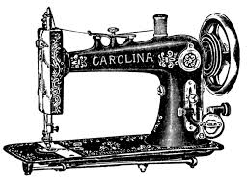
Prototype
Goal: (freely) experiment with these ideas
Weka does not provide such freedom
No need for special ML libraries (happily)
A dedicated, hand-made piece of software:
Written in Objective Caml (Ocaml)
20 modules, 3.600 lines of code
Export a Weka datafile when ML tools are needed.

Slide 38




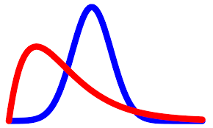



Prototype workflow
Training Dataset
(Valid Behavior)
HTTP Field
Model
Model
Parameters
Priors
Reference Model
Ngram Model
HTTP REQ
Parser
Ngram Tokenizer
Ngram Outlier Detector
Instance Outlier Detector
Splitter
ARFF
Test Model List
Autotest
(Valid cases)
Test File
(Attacks)
Autotest
Report
Test File
Report

Slide 39
Datatypes
Distribution
Tries (n-gram model)
type distrib = {
(* Mean *)
mean : float;
(* sigmanum = sigma^2/(num-2) *)
sigmanum : float;
(* minimum value sampled *)
minval : float;
(* maximum value sampled *)
maxval : float;
(* Amount of sampled values *)
num : int
}
type tries =
| Node of (symbol,distrib*tries) Hashtbl.t
a
z
b
d_{a}
d_{b}
…
d_{z}
a
…
e
Hashtables
Many of them
d_{ba}
d_{be}
…
…
…

Slide 40
Configuration files
HEADER
NgramLength = 3
MinimumNgramMean = 0.01 0.009 0.003
MinimumUrlMean = 0.01
MinimumDistance = 0.1 0.1 0.1
Verbose = false
Inversion = true
Prior = "spanish_trigrams.txt"
…..
FIELDS
Field 2
Tokenization Delimiter "/"
Method NumberInField
end
Field 3
Subfields "&" "="
end
Field 3 password
Tokenization Exclude
end
Field 3 apellidos
Method FrequencyInField Spanish
end
Field 3 login
Tokenization Ngram 1
end
N
m
n

Slide 41

Efficiency constraints
Deforestation techniques required to deal with huge datasets in RAM
Do not let the structures grow: print to external file as soon as possible
Avoid keeping intermediate data structures (lists)
Therefore, avoid abusing of List.map
This is a typical Big Data (=map and reduce) use case!
Compromise:
Train on the whole dataset
Test on randomly chosen subsets (about 10% of the original ones)
Compute attribute extraction several times (don’t save it in RAM)

Slide 42
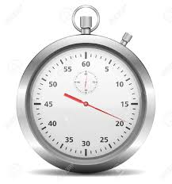
Time performance
Test case | Execution time(*)
Training on 36.000 HTTP requests + Testing on 4.022 normal cases | 2’58 min
Training on 36.000 HTTP requests + Testing on 2.818 abnormal cases | 3’35 min
Training on 36.000 HTTP requests + Testing on 25.065 abnormal cases | 4’33 min
(*) Executed on a Dell Inspiron with Intel CORE i7 laptop
Model has 28.319 n-grams, n=1,2,3.

Slide 43
ARFF format drawbacks
Weka requires some datastructures to be sorted … and hence to keep all the elements in memory.
Example: attributes in the instances shall be listed in order
The attributes are known after processing all the instances, but should be printed in first place, and therefore kept in memory.

Slide 44
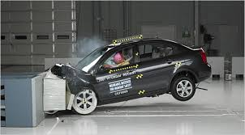
Experimental results

Slide 45

Choosing the dataset
Start working on the ECML/PKDD2007 challenge
Unfortunately useless for pattern recognition experiments
Data masked with random values.
Any pattern in the data has been removed.
Moved to CISC2010 dataset
An (tiny) on-line retail store
Split into two pieces:
36.000 normal HTTP requests
25.000 abnormal HTTP requests (attacks)
Advantage: for Spanish users (differences with SQL maximized!)

Slide 46
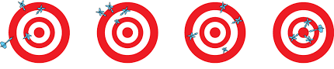
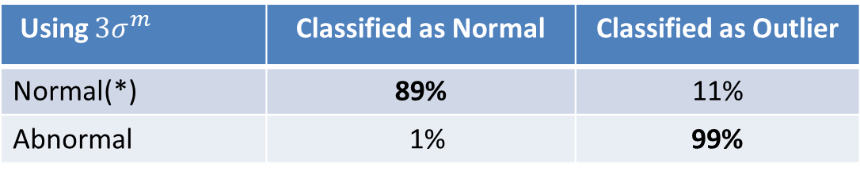
Accuracy
Using Min-Max | Classified as Normal | Classified as Outlier
Normal(*) | 95% | 5%
Abnormal | 3% | 97%
Using $3σ^{m}$ | Classified as Normal | Classified as Outlier
Normal(*) | 89% | 11%
Abnormal | 1% | 99%
(*) From a randomly chosen control sub-dataset formed with about 1/10th of the valid training data.

Slide 47

Explanation of failures
False negatives:
Fields with random values are ignored (e.g. passwords)
Apparently misclassified instances in the dataset….
False positives:
Mostly because the prior does not contain white spaces in the frequencies
Because of rare trigrams too, of course…

Slide 48
Examples
[Show some cases from the logs here]

Slide 49
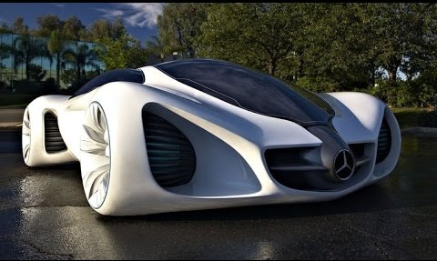
Future Work

Slide 50

Further work
Improve efficiency:
Migrate from Ocaml to Scala / Spark
Execute on ICT4V’s Big Data Platform
Implement model marshalling
Better understand the underlying distributions and wrong statistical assumptions:
Graphical tools for visualizing distributions
Validate idea using other datasets (FING dataset)

Slide 51
Further work
Multi-language approach:
Search for language delimiters, such as “;” or “´”
Measure distances to each language (clustering)
Is there a dataset of SQL programs? Of XPath queries?
userName := Eduardo Giménez ’ ; DROP Table users; SELECT userinfo WHERE ‘t’=‘t
Uruguayan names
SQL: a complete different language.

Slide 52

What can be expected from the attackers in the future?

Slide 53
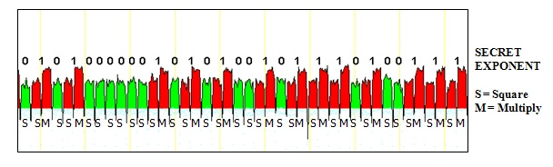
The song remains the same
Differential Power Analysis attacks on smart cards
Correlates cryptographic key values with raw, physical, low level data, leaked from program execution, such as: elapsed time, power consumption, heat dissipation, electromagnetic fields variations on the chip.
A devastating technique in the 1990…
Usual countermeasures: hide power consumption, introduce statistically admissible noise, balance your program code.

Slide 54

The next attacker’s move
Hide the code to be injected as much as possible, diluting it into valid text (statistically admissible noise).
Name=Eduardo Giménez Perez González Martínez Díaz Marrero Nadal Berrutti Suárez O’;drop table users....
But:
Field length protect us (if it is not free text)
Smarter techniques using language delimiters
Fight continues….

Slide 55
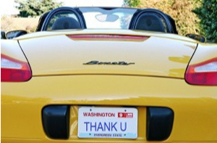
Thank you!
More questions?

Slide 56
Some references
N-gram language text categorization, William Cavnar and Jhon Trenkle, Environemental Reserch Institute of Michigan.
Language identification on the web: extending the dictionnary method, Radim Rehurek (Masaryk University) and Milan Kolkus (Sezam.com).
A multi-model approach to the detection of web-based attacks, Christopher Kruegel and Giovanni Vigna, William Robertson, University of California.

